Slide 1



Byun - Dennany - Tolle - Wendholt
Spring 2021 - CSCI-B 457 - Group 8

Slide 2

Agenda
01
Project Description
02
Implementation
03
Challenges
04
Live Demo & Results
Notes:
To give some context of what I’ll be covering today - I’ll start by giving a description of our project, then I will get into the details of our projects implementation and some of the challenges we faced along the way. After that I’ll give a live demo of our algorithm, and finally will share the results of our project.

Slide 3
01
Project Description
Problem: Classify images of first generation pokemon
Solution: Deep Convolutional Neural Network
Notes:
What we set out to do in this project is to create an algorithm that can take as input an image of a pokemon and then correctly classify it by name. To do this classification, we used a convolutional neural network.

Slide 4
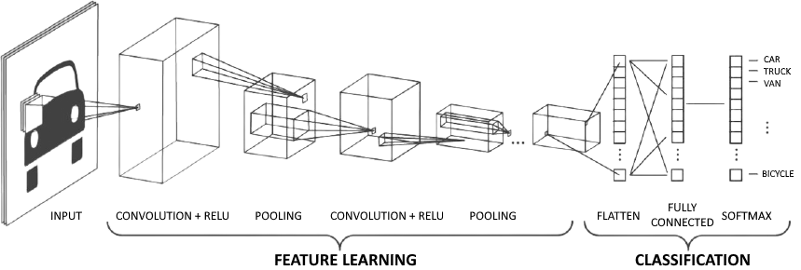
Convolutional Neural Network (CNN)
Three main components:
Convolve images with multiple filters
Introducing non-linearity and downsampling
Feeding output from Step 1 & 2 into a deep neural network
Notes:
A Convolutional Neural Network is a common technique used in image classification. It involves three main steps:
The first step is convolving each image with a bunch of different filters to obtain feature maps. We learned about a lot of these filters in class, such as sharpening, edge detection, blurring, and other common filters.
The second step is to introduce a non-linearity to each filter map, such as ReLU or sigmoid, and then downsampling each non-linear filter map. A common downsampling technique is max-pooling, which goes over the image in squares and takes the pixel with the highest value as the representative of that square in the image. This results in a reduction of the dimensionality of the image.
The third and final step is to input each of these downsampled, non-linear filter maps into a fully connected deep neural network to make classifications.

Slide 5
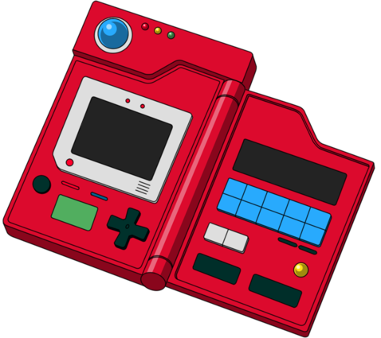
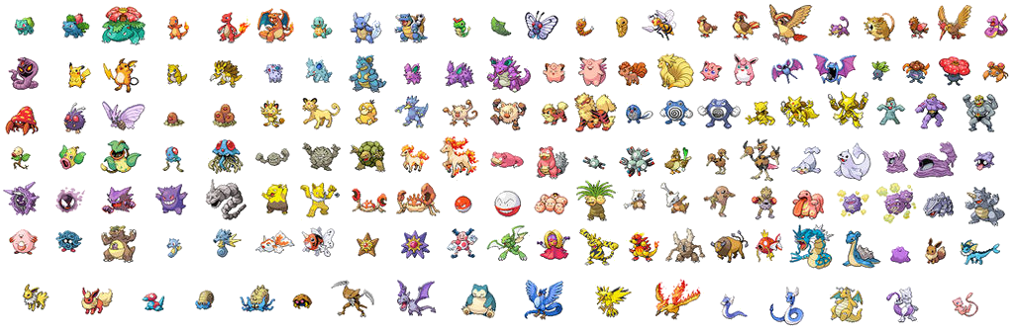
The Dataset
Kaggle dataset can be found here
Over 10,000 total images
151 unique Gen-1 Pokemon
Notes:
We obtained our dataset through Kaggle, which has a set of over 10 thousand images of first generation pokemon. Each image varies in size and file type, and there are 151 unique pokemon in the dataset.

Slide 6




Tools used
Notes:
Tools worth mentioning that we used were tensorflow and specifically the keras interface in the tensorflow library. This helped us a lot in automating a lot of the details involved in the convolutional neural network. We also hosted our algorithm on google colab so that we could use the google clouds pre-installed libraries and GPU.

Slide 7
02
Implementation
Notes:
Aright, so now I will get into the details of our projects implementation.

Slide 8
Implementation: Data Pre-Processing
Cleaned dataset
Used 15 unique Pokemon
Convert image formats and sizes.
Split into training, validation, and testing sets
Notes:
This project required a lot of data-preprocessing. First, the dataset was way too large and would cause the program to crash simply on loading the images in, so we decided to only use images of 15 different unique Pokemon. This reduced dataset still had about twelve hundred images in it. The dataset also had some bad images in it, like a few instances where a pokemon was labeled incorrectly, so we had to go through and manually delete these bad images from the dataset.
The dataset also contained images of all different types of file extensions, so we had to convert them all to the same extension. We converted them all to jpeg format. Additionally, a CNN requires that all of the input images be of the same size, so we had to re-size all of the images to the same scale. We converted each image to be the average size of all the images in the dataset, which was 783 pixels wide by 704 pixels tall.
Finally we had to split the dataset into training, validation, and testing sets. We used 70% of the images for training, and 15% of the images for validation and testing.

Slide 9
Implementation: CNN
Image Processing
Number of feature maps: 96
Non-linearity: ReLU
Downsampling: Max-Pooling in 2x2 squares
Deep Neural Network
4 fully connected layers
15 output nodes
Notes:
For the image processing part of the CNN, which were steps 1 and 2 that I described earlier, we applied 96 different filters. The non-linear function we applied to each feature map was ReLU, which essentially just sets any negative pixel values equal to zero, and leaves all of the positive pixel values the same. We then down-sampled each feature map using max-pooling in 2 by 2 squares.
We then fed these processed images into a 4 layered, fully connected deep neural network. The first layer has 250 nodes, the second layer has 200 nodes, the third layer has 100 nodes, and the output layer has 15 nodes - one node for each possible pokemon.

Slide 10
03
Challenges
Notes:
This project came with a few challenges, such as:

Slide 11

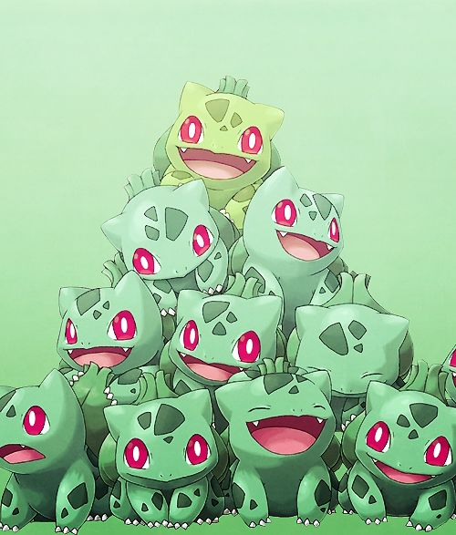
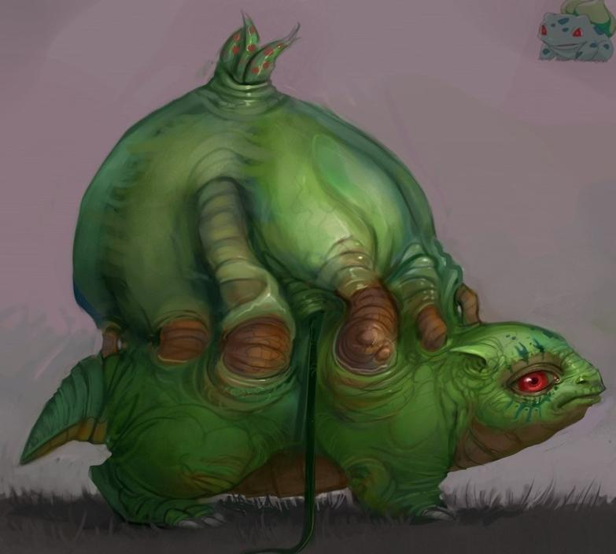

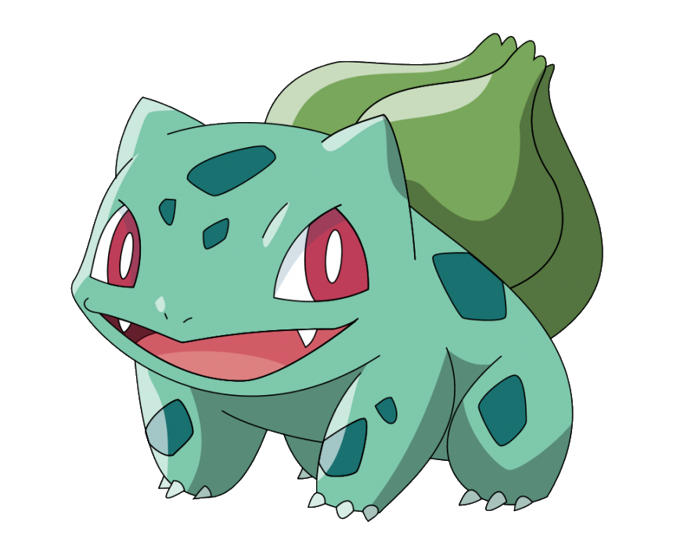
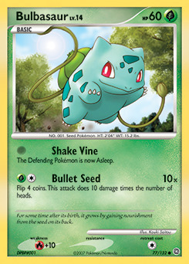



Challenges (Part 1):
Image variations
Notes:
Image variations. As with any image classification task, a major challenge was the variation in the dataset of images that were supposed to represent the same class.
The middle image is what we’d consider a “good” representation of Bulbasaur - it’s a clear image of only bulbasaur with no variation. You can see the different variations in Bulbasaur interpretations as well: the top photo is a minimalist style of it, the top-right photo is a hyper-realistic representation, and the bottom photo the bulbasaur is in cake form. Also, you can see there are some images with text on it, as well as images where bulbasaur appears more than once in the image. This is a common theme throughout the dataset.

Slide 12

Challenges (Part 2):
Data pre-processing
RAM space
Overfitting the network
Notes:
One of the main limitations of our algorithm was the RAM capacity of colab. It would have been great if we could have applied hundreds of filters to each image, and then fed each feature map into a neural network containing many layers and thousands of nodes. However, our network as it is now almost maxes out the RAM capabilities of colab, so our network size is maxed out at it’s current architecture.
Another challenge we faced was overfitting our CNN to the training data. We used two techniques to avoid this. The first technique we used is called “early stopping.” This technique tests the network on the validation data after each training iteration, and when the error from testing with the validation data begins to increase, we quit training the network. We also used a technique called “dropout”, which randomly removes some of the networks nodes during training. This makes the network architecture slightly different in each training iteration, and so each update to the network is performed with a slightly different “view” of the it.

Slide 13
04
Live Demo
&
Results

Slide 14
Results:
76% accuracy on training data
Random Choice: 1/15 = 6.7% accuracy
Notes:
Our model has 76% accuracy on the testing data, which is a decent classification result considering the probability of randomly selecting the correct class out of 15 classes is 6.7%. So, our CNN performs a little over eleven times better than just randomly classifying the images.

Slide 15

Future Improvements
Recognize pokemon first
Increase size of cnn ⇔ increase ram capacity
Notes:
Some improvements we could make to our algorithm would be to pre-process the images to recognize the specific pokemon before applying all of the steps of the CNN. We could possibly do this through some segmentation technique, and would help in classifying the images that had multiple pokemon in it or text on it. We also think that increasing the complexity of the network would improve its performance, but we would need higher ram capabilities to be able to do that.

Slide 16
Resources
MIT Intro to Deep Learning (Specifically Lecture 6)
http://introtodeeplearning.com/
Reference Paper
https://www.hindawi.com/journals/cin/2016/3289801/
Kaggle Dataset:
https://www.kaggle.com/thedagger/pokemon-generation-one
Notes:
And here are some of the resources we used

Slide 17
Thank you!
Any questions?

